Slide 1
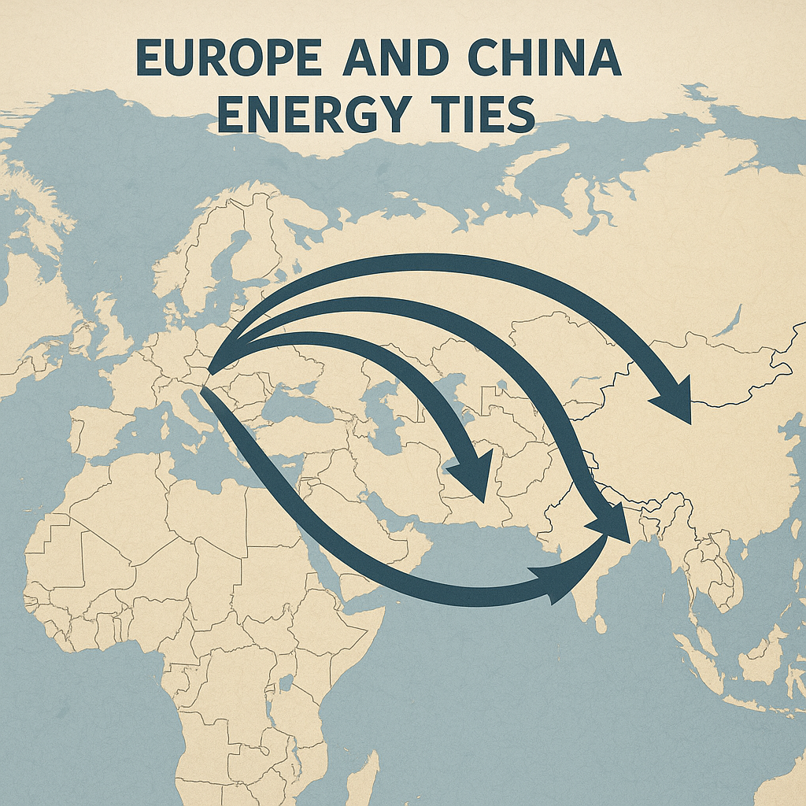
Joint Venture Approval
NTPC Green Energy and GAIL have established a 50:50 joint venture.
The joint venture has received necessary approvals.

Slide 2

Focus on Shares
NTPC Green Energy shares are currently the subject of market interest.
The partnership with GAIL is drawing attention from investors.

Slide 3
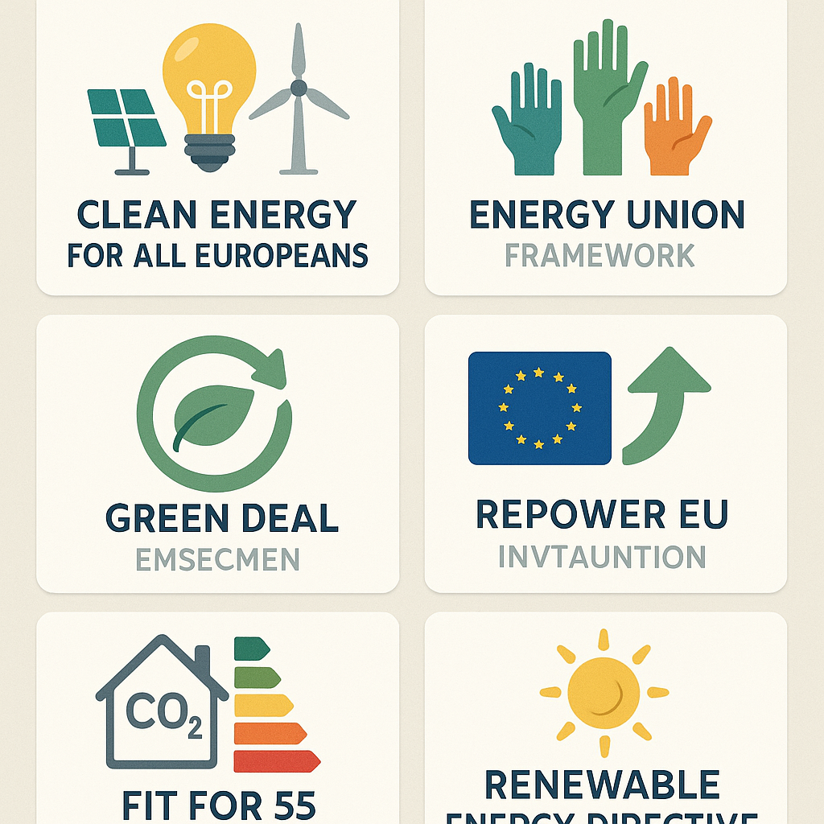
Strategic Importance
The joint venture is expected to enhance NTPC Green Energy's capacity.
Collaboration with GAIL may lead to increased operational efficiency.

Slide 4

Market Impact
The approval of the joint venture could positively impact stock performance.
Market analysts are closely watching NTPC Green Energy's developments.

Slide 5
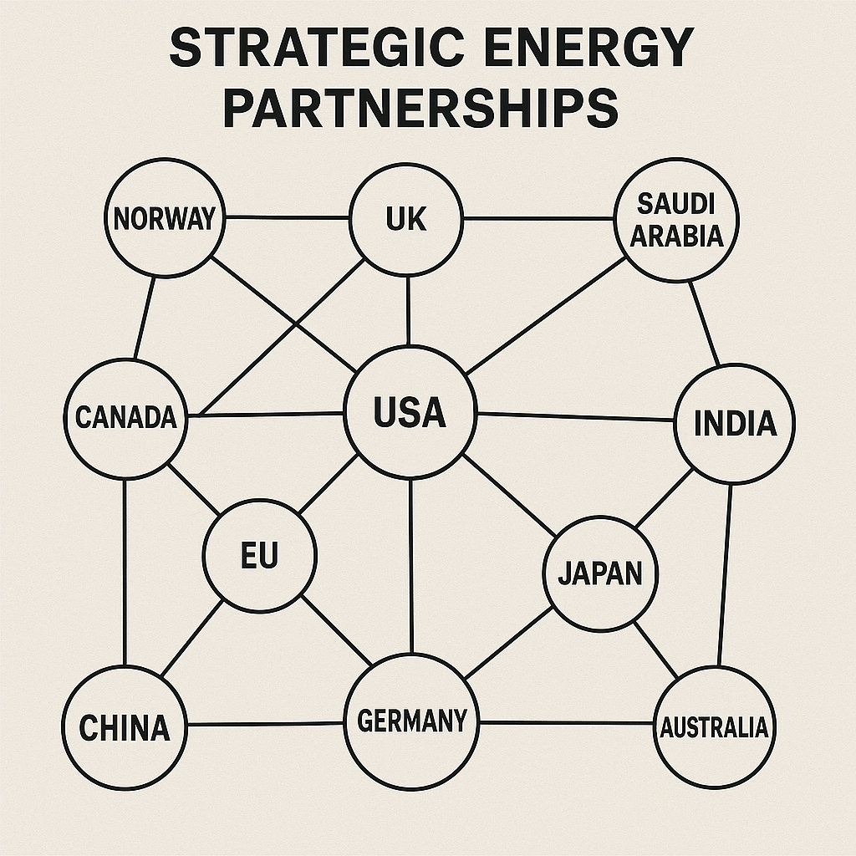
Investment Potential
The 50:50 partnership signifies a mutual investment strategy.
Both companies aim to leverage resources for green energy initiatives.

Slide 6
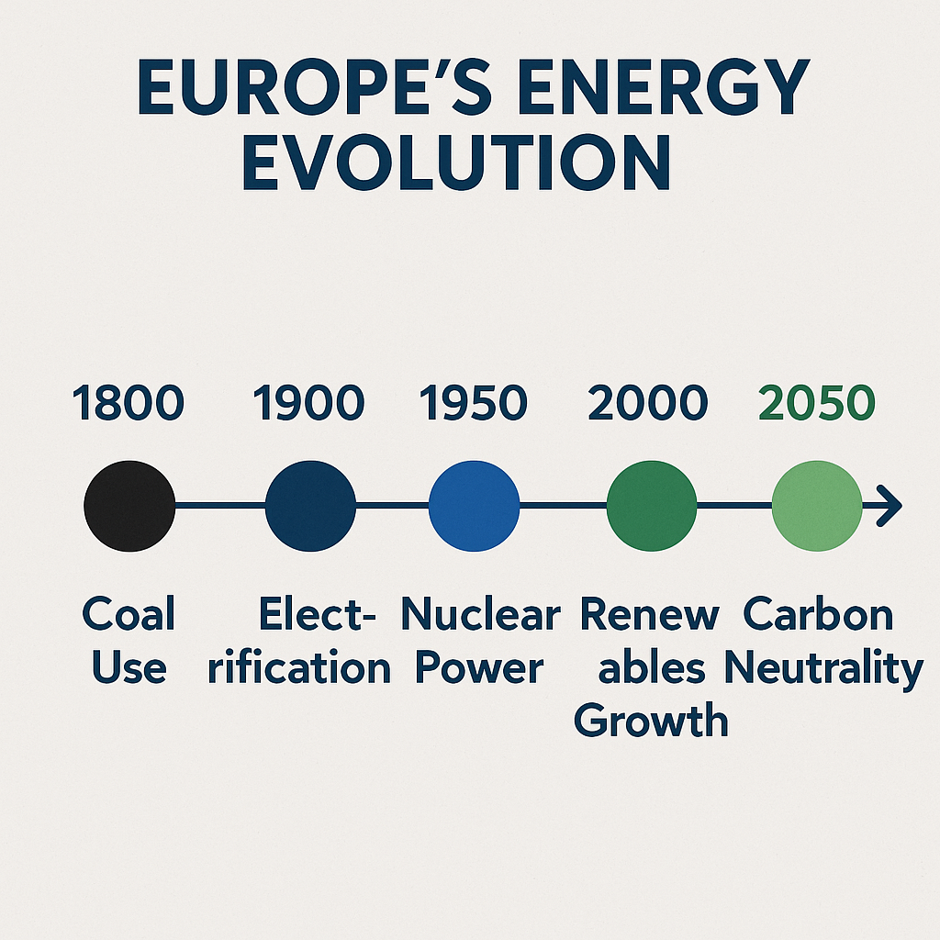
Future Prospects
The collaboration opens avenues for potential expansion in renewable energy.
Future growth is likely aligned with government policies on green energy.

